Slide 1

AI training group
Weekly Report
Nguyen khai phu – SEP 22 2023

Slide 2
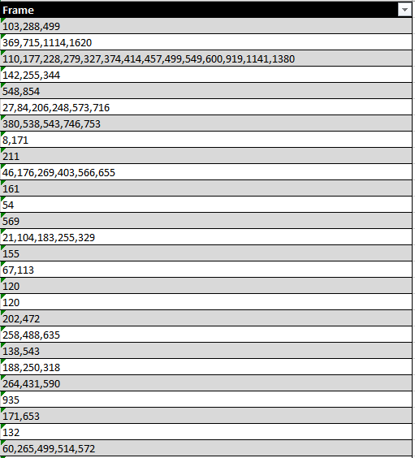
ISP008 foundation
40 videos
Only Capture/Emulator
2
CISP-1352-A21 - ISP-DOC-STYLETYPE-Templates © Robert Bosch GmbH 2016. All rights reserved, also regarding any disposal, exploitation, reproduction, editing, distribution, as well as in the event of applications for industrial property rights.

Slide 3
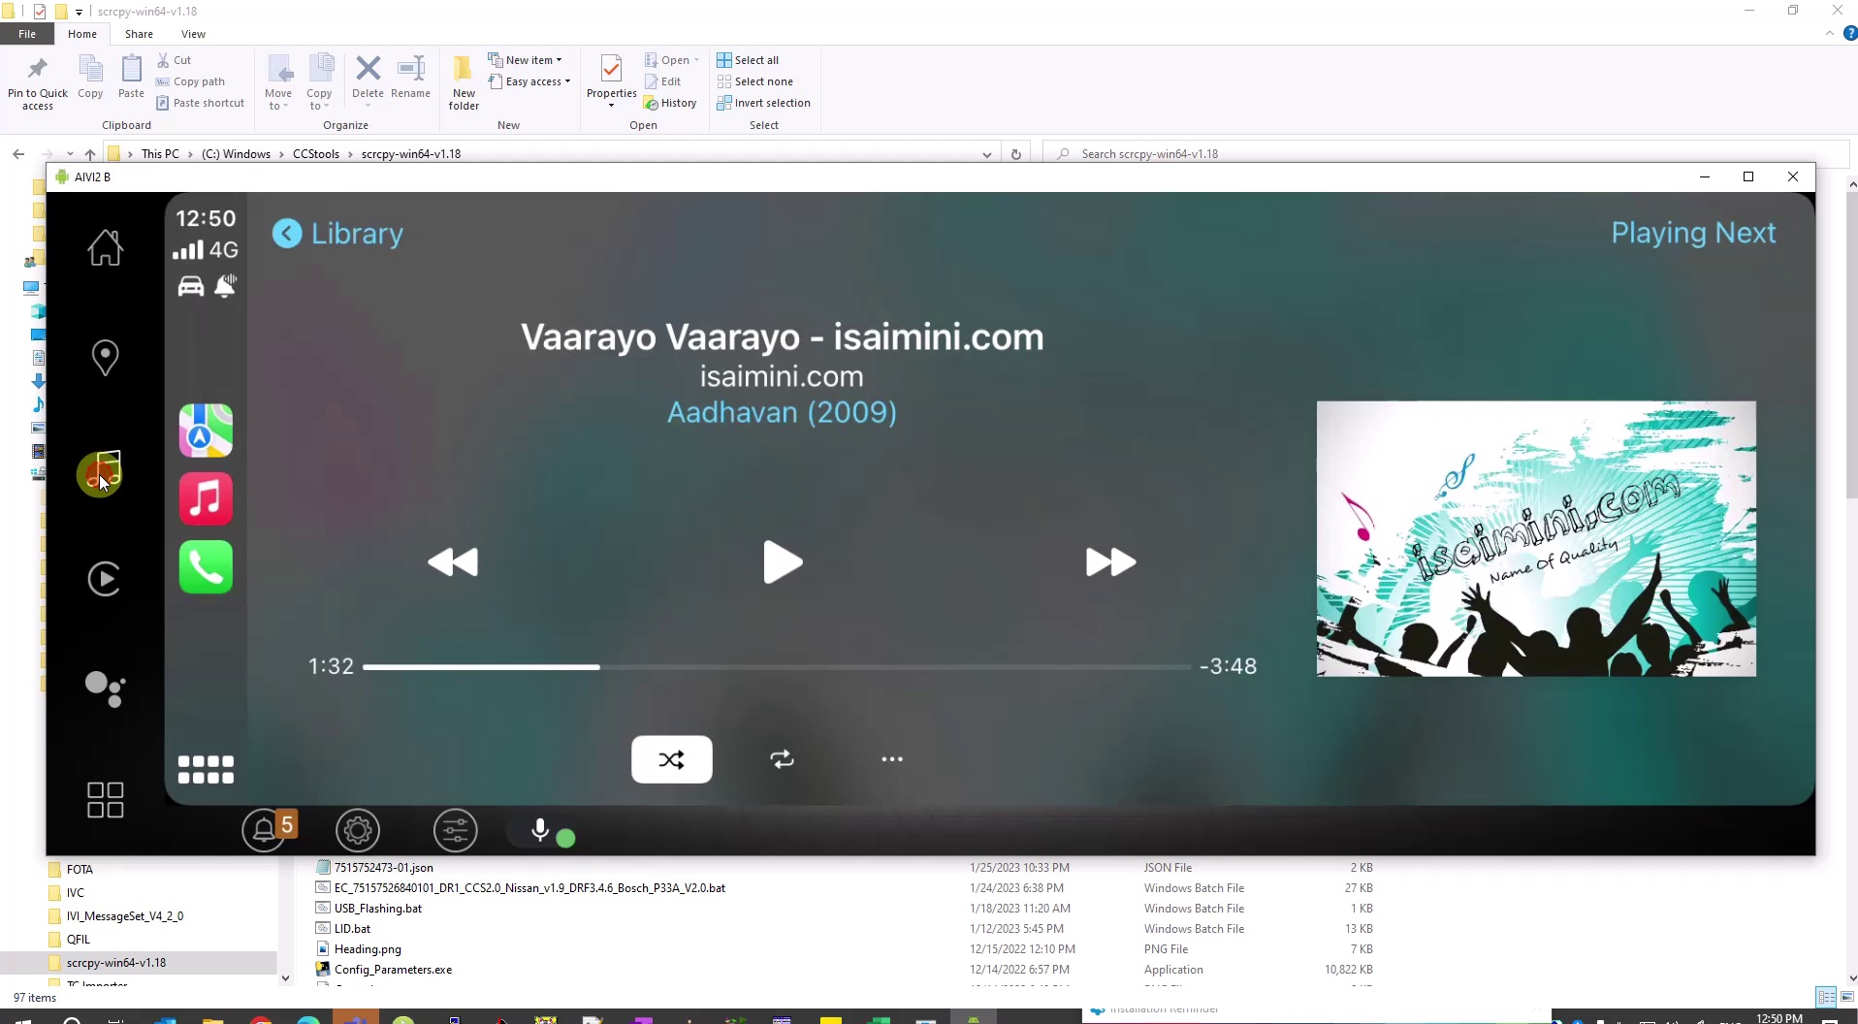
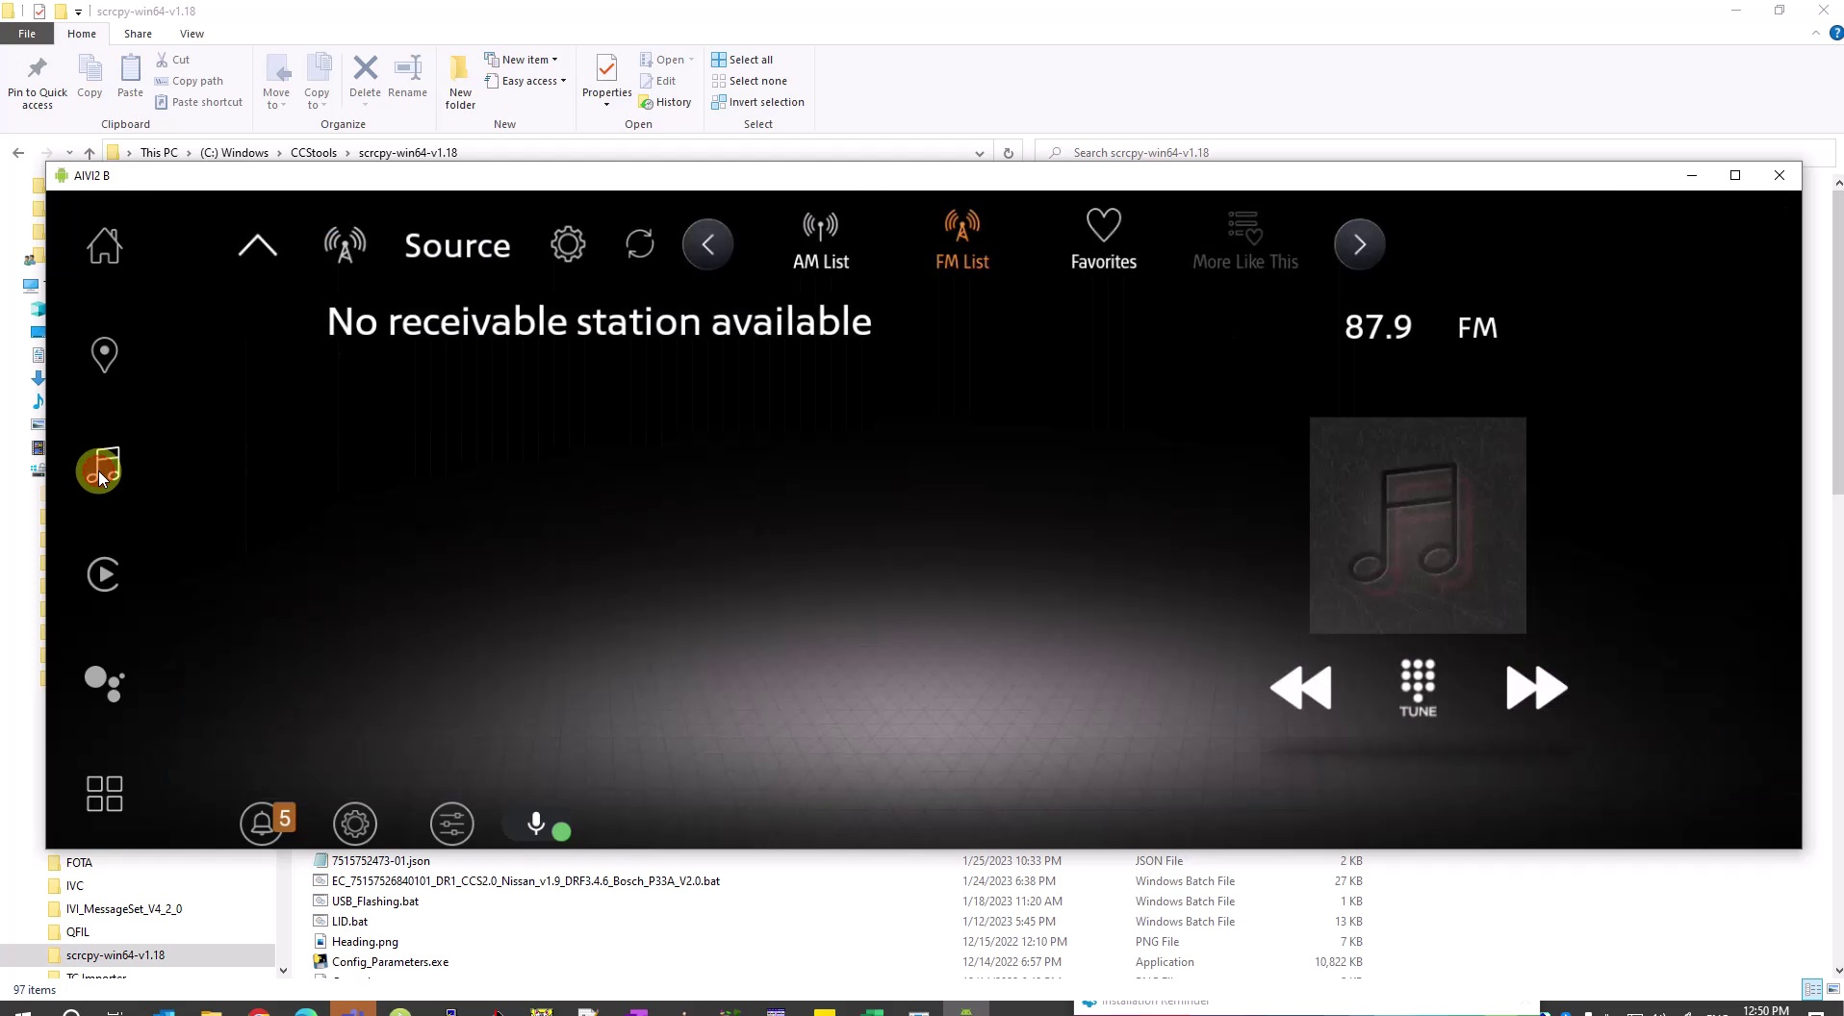

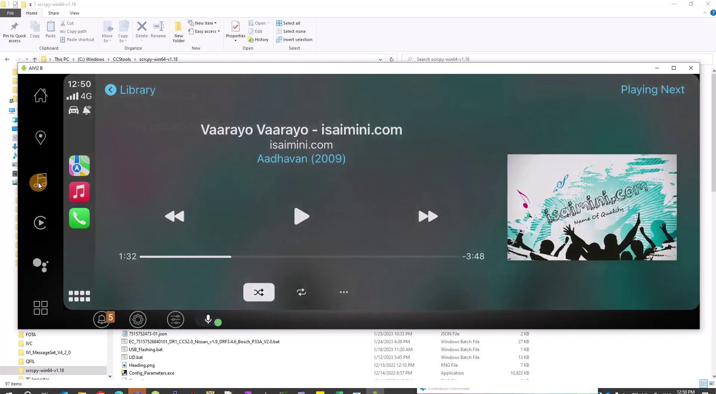
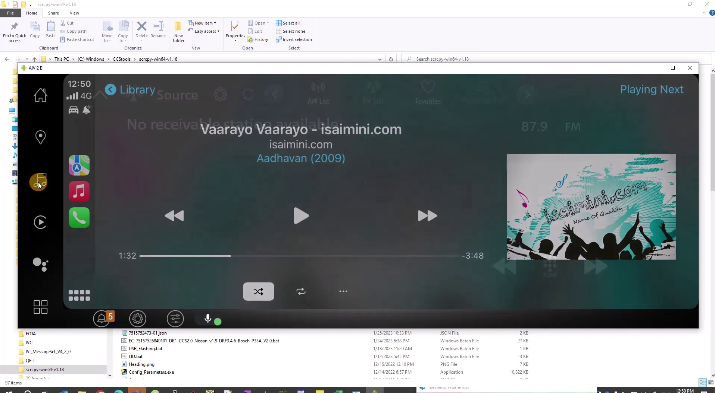
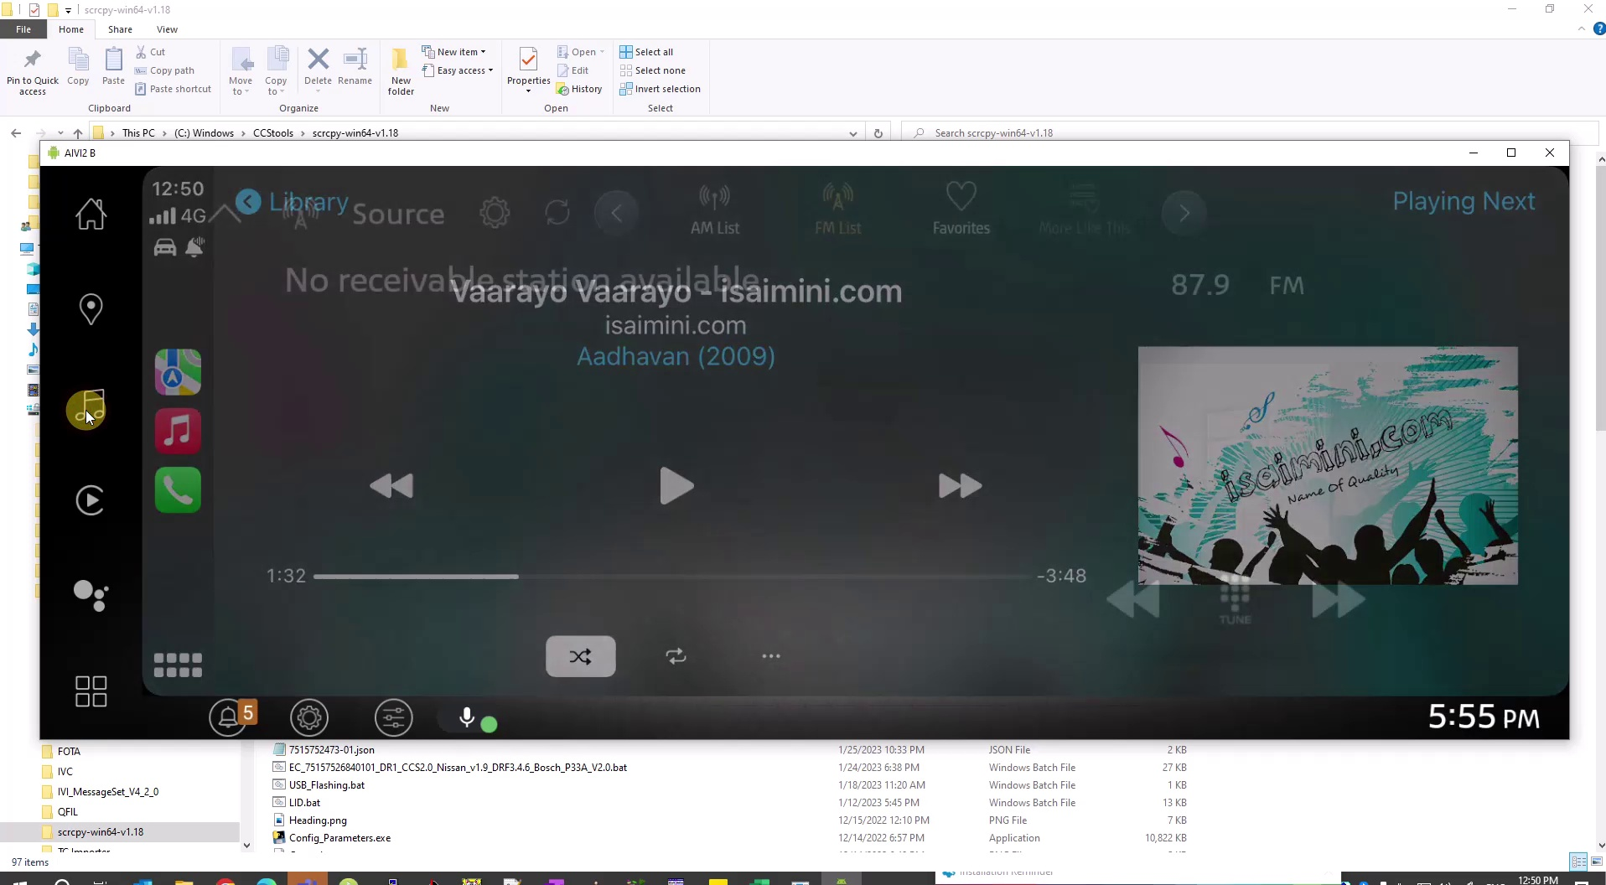
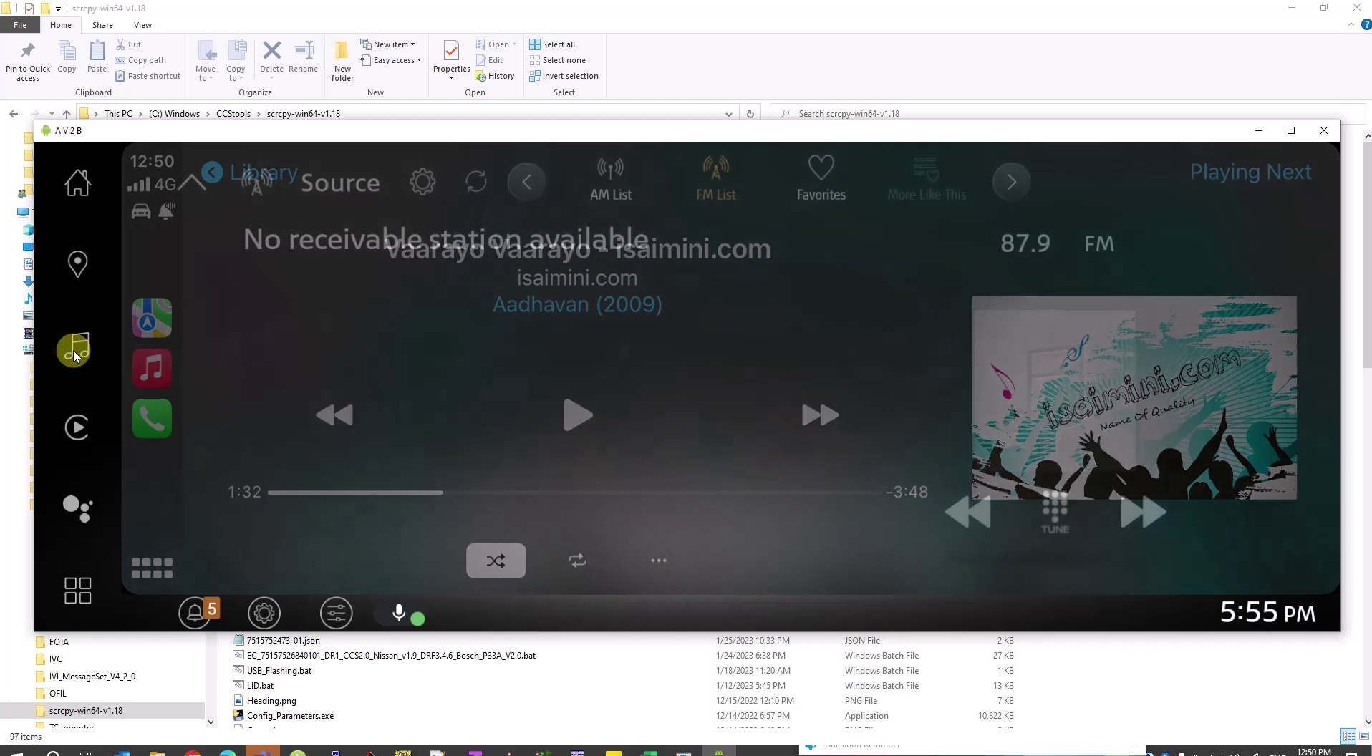
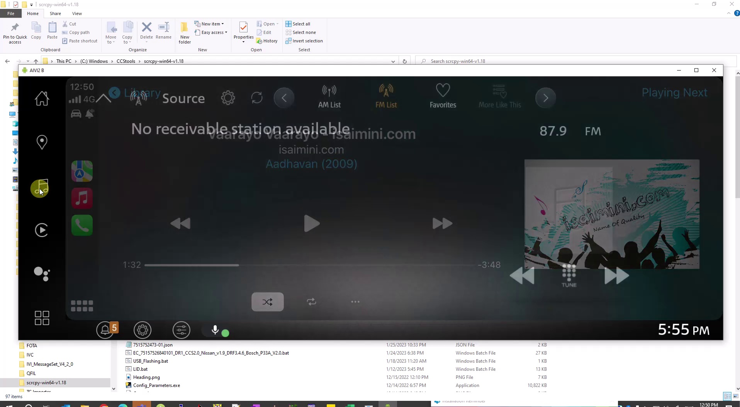
First approach
ISP008 foundation
Shot detection (cut detection)
Miniscule intervals between 2 cuts -> flicker (current implementation is < 0.4s)
2
CISP-1352-A21 - ISP-DOC-STYLETYPE-Templates © Robert Bosch GmbH 2016. All rights reserved, also regarding any disposal, exploitation, reproduction, editing, distribution, as well as in the event of applications for industrial property rights.

Slide 4

Shot detection
ISP008 foundation
PySceneDetect (github.com) – ContentDetector
Open source
Goal: Split videos into seperate scenes by detecting cuts
Python APIs
2
CISP-1352-A21 - ISP-DOC-STYLETYPE-Templates © Robert Bosch GmbH 2016. All rights reserved, also regarding any disposal, exploitation, reproduction, editing, distribution, as well as in the event of applications for industrial property rights.

Slide 5
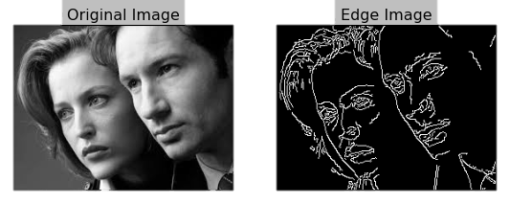
Metrics used for detection
ISP008 foundation
Convert all frames to HSV space
Compare each pair of consecutive frames and calculate:
delta_hue: Hue difference
delta_sat: Saturation difference
delta_lum: Value difference
delta_edges: Edge difference (using OpenCV’s Canny)
OpenCV 3 Canny Edge Detection - 2020 (bogotobogo.com)
2
CISP-1352-A21 - ISP-DOC-STYLETYPE-Templates © Robert Bosch GmbH 2016. All rights reserved, also regarding any disposal, exploitation, reproduction, editing, distribution, as well as in the event of applications for industrial property rights.

Slide 6
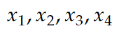
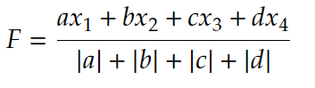
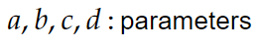
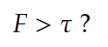
Metrics used for detection
ISP008 foundation
Convert all frames to HSV space
Compare each pair of consecutive frames and calculate:
delta_hue: Hue difference
delta_sat: Saturation difference
delta_lum: Value difference
delta_edges: Edge difference (using OpenCV’s Canny)
OpenCV 3 Canny Edge Detection - 2020 (bogotobogo.com)
(threshold)
2
CISP-1352-A21 - ISP-DOC-STYLETYPE-Templates © Robert Bosch GmbH 2016. All rights reserved, also regarding any disposal, exploitation, reproduction, editing, distribution, as well as in the event of applications for industrial property rights.

Slide 7
ISP008 foundation
107
108
109
110
2
CISP-1352-A21 - ISP-DOC-STYLETYPE-Templates © Robert Bosch GmbH 2016. All rights reserved, also regarding any disposal, exploitation, reproduction, editing, distribution, as well as in the event of applications for industrial property rights.

Slide 8
Performance & Challenges
ISP008 foundation
Current performance
Correct (TP): 72
False (FP): 557
Missed (FN): 42
Too many false detections:
2
CISP-1352-A21 - ISP-DOC-STYLETYPE-Templates © Robert Bosch GmbH 2016. All rights reserved, also regarding any disposal, exploitation, reproduction, editing, distribution, as well as in the event of applications for industrial property rights.

Slide 9
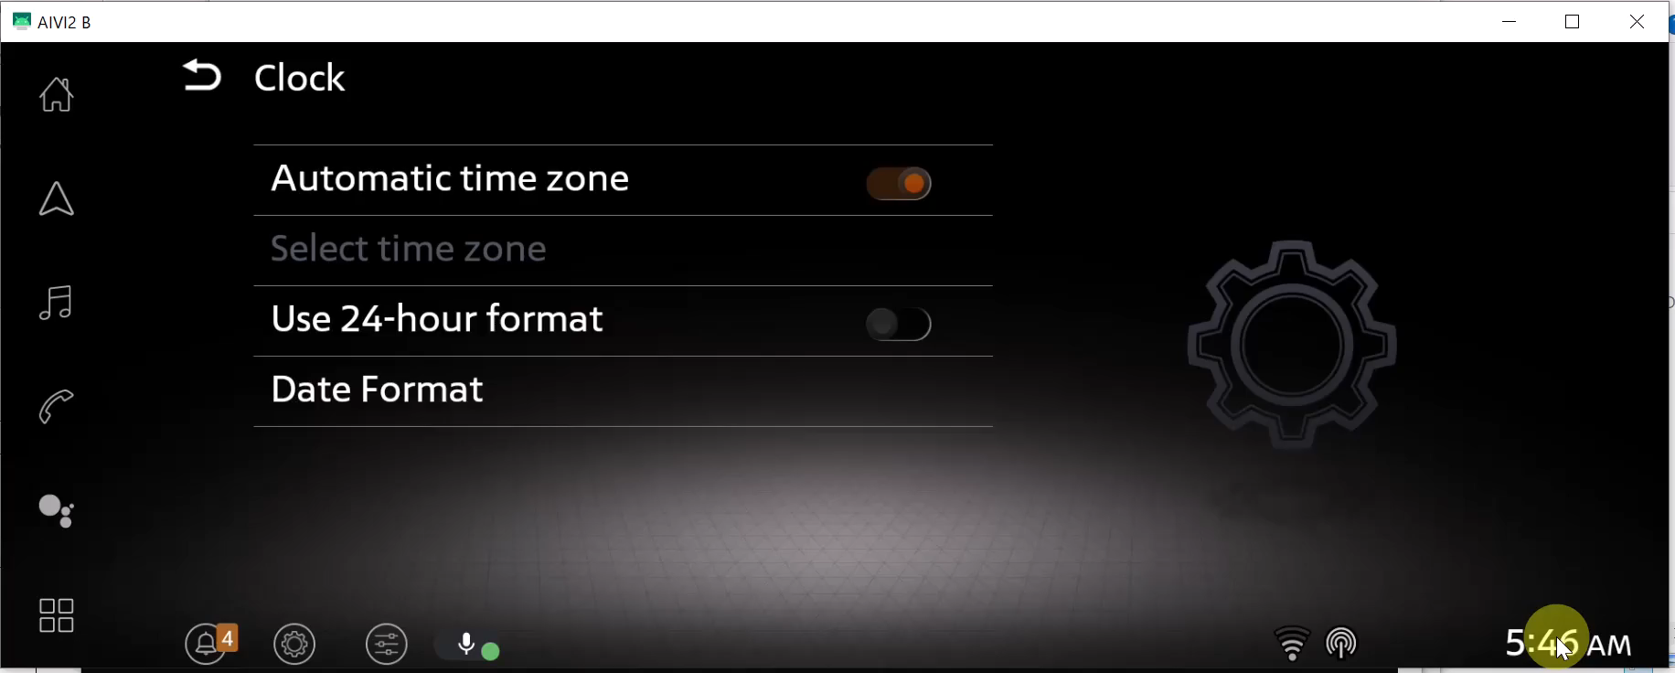
Performance & Challenges
ISP008 foundation
Current performance
Correct (TP): 72
False (FP): 557
Missed (FN): 42
Too many false detections:
2
CISP-1352-A21 - ISP-DOC-STYLETYPE-Templates © Robert Bosch GmbH 2016. All rights reserved, also regarding any disposal, exploitation, reproduction, editing, distribution, as well as in the event of applications for industrial property rights.

Slide 10
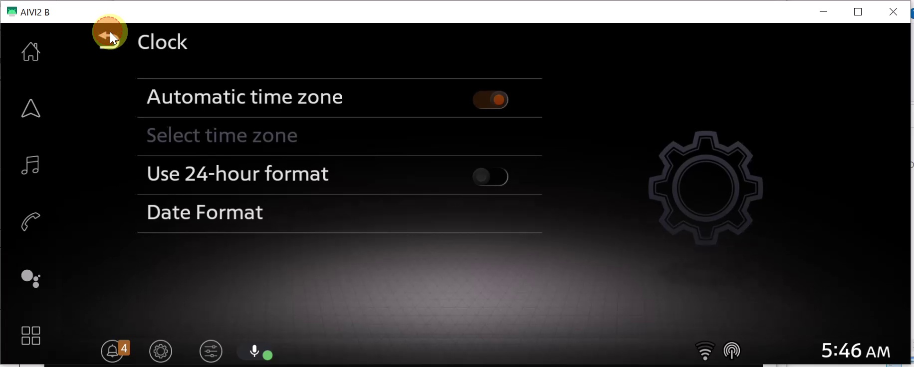
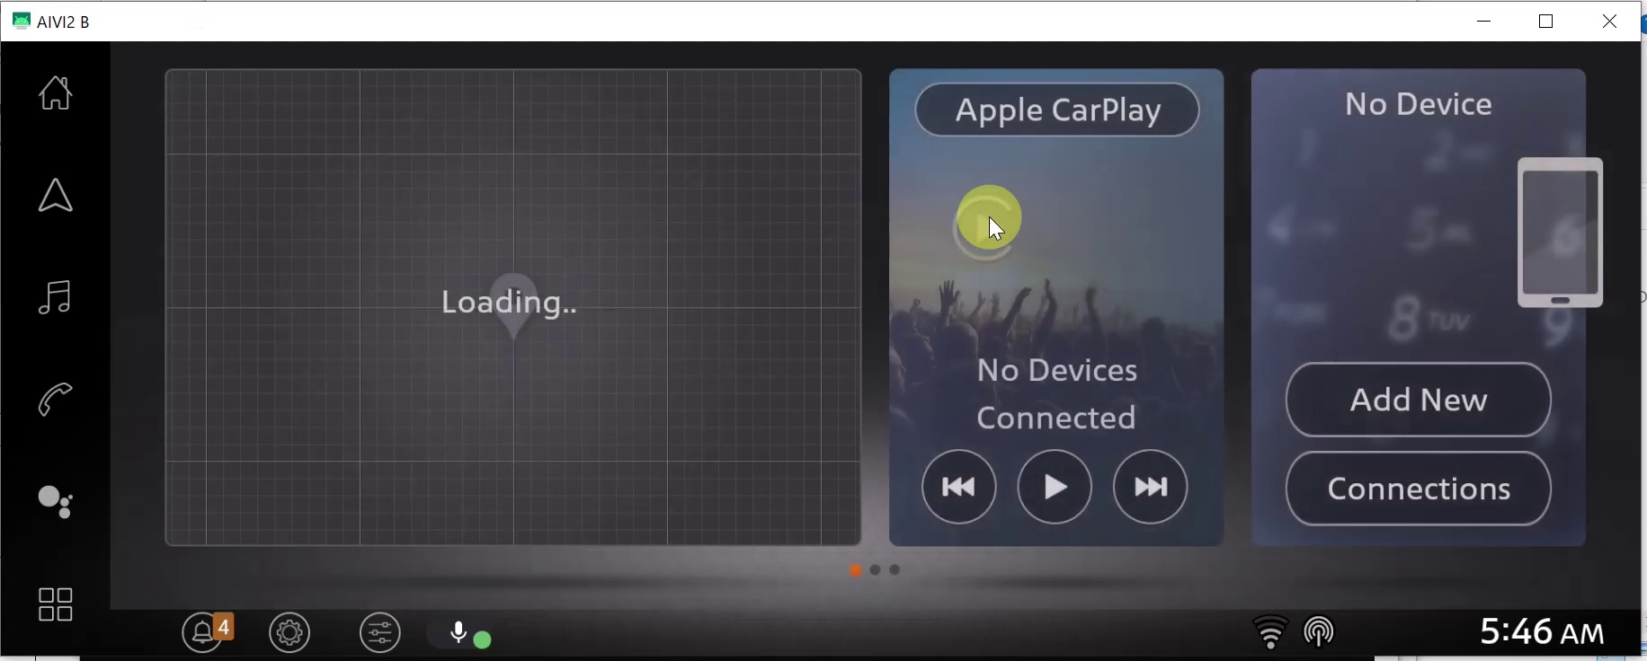
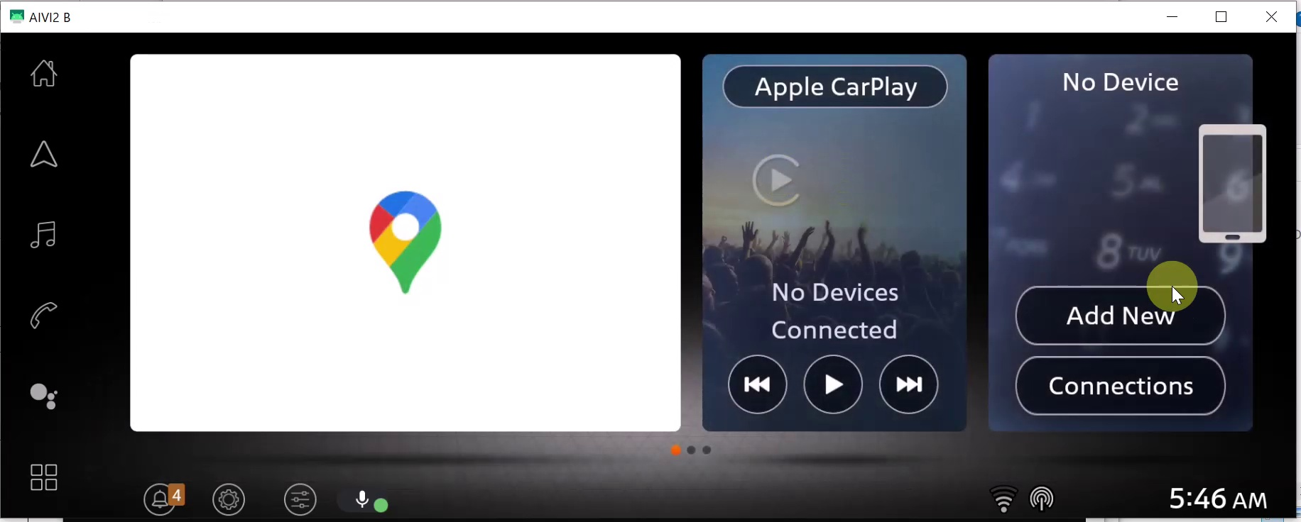
Performance & Challenges
ISP008 foundation
Current performance
Correct (TP): 72
False (FP): 557
Missed (FN): 42
Too many false detections:
Load pages and widgets: normal(?) behavior
2
CISP-1352-A21 - ISP-DOC-STYLETYPE-Templates © Robert Bosch GmbH 2016. All rights reserved, also regarding any disposal, exploitation, reproduction, editing, distribution, as well as in the event of applications for industrial property rights.

Slide 11
Performance & Challenges
ISP008 foundation
Current performance
Correct (TP): 72
False (FP): 557
Missed (FN): 42
Too many false detections:
Load pages and widgets: normal(?) behavior
Missed:
Small difference between affected frames
2
CISP-1352-A21 - ISP-DOC-STYLETYPE-Templates © Robert Bosch GmbH 2016. All rights reserved, also regarding any disposal, exploitation, reproduction, editing, distribution, as well as in the event of applications for industrial property rights.

Slide 12
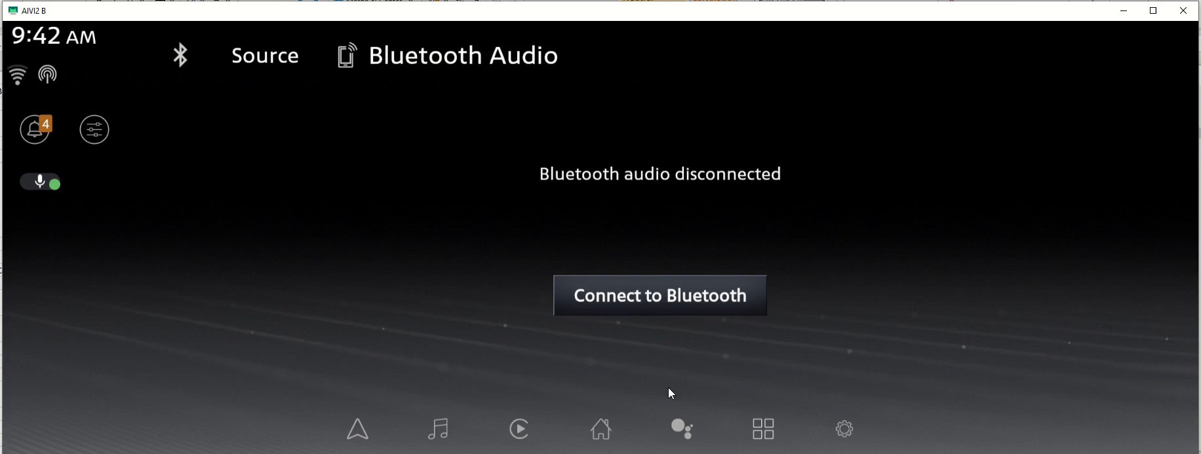
Performance & Challenges
ISP008 foundation
Current performance
Correct (TP): 72
False (FP): 557
Missed (FN): 42
Too many false detections:
Load pages and widgets: normal(?) behavior
Missed:
Small difference between affected frames
2
CISP-1352-A21 - ISP-DOC-STYLETYPE-Templates © Robert Bosch GmbH 2016. All rights reserved, also regarding any disposal, exploitation, reproduction, editing, distribution, as well as in the event of applications for industrial property rights.

Slide 13
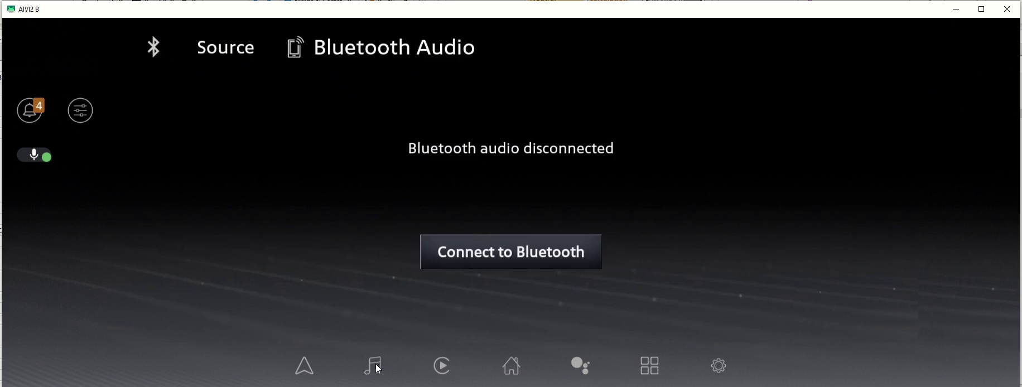
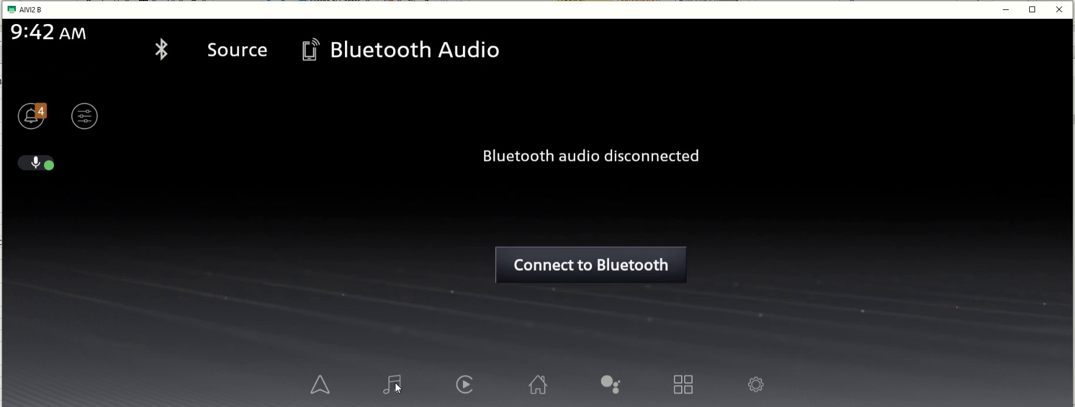
Performance & Challenges
ISP008 foundation
Current performance
Correct (TP): 72
False (FP): 557
Missed (FN): 42
Too many false detections:
Load pages and widgets: normal(?) behavior
Missed:
Small difference between affected frames
Reduce missed hits might lead to increasing false detections
2
CISP-1352-A21 - ISP-DOC-STYLETYPE-Templates © Robert Bosch GmbH 2016. All rights reserved, also regarding any disposal, exploitation, reproduction, editing, distribution, as well as in the event of applications for industrial property rights.

